Slide 1
Digital Design & Computer Arch. Lecture 1: Introduction and Basics
Prof. Onur Mutlu
ETH Zürich
Spring 2020
20 February 2020

Slide 2
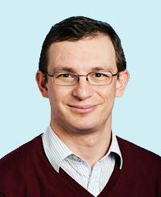
Brief Self Introduction
Onur Mutlu
Full Professor @ ETH Zurich CS (EE), since September 2015
Strecker Professor @ Carnegie Mellon University ECE/CS, 2009-2016, 2016-…
PhD from UT-Austin, worked at Google, VMware, Microsoft Research, Intel, AMD
https://people.inf.ethz.ch/omutlu/
omutlu@gmail.com (Best way to reach me)
https://people.inf.ethz.ch/omutlu/projects.htm
Research and Teaching in:
Computer architecture, computer systems, hardware security, bioinformatics
Memory and storage systems
Hardware security, safety, predictability
Fault tolerance
Hardware/software cooperation
Architectures for bioinformatics, health, medicine
…

Slide 3
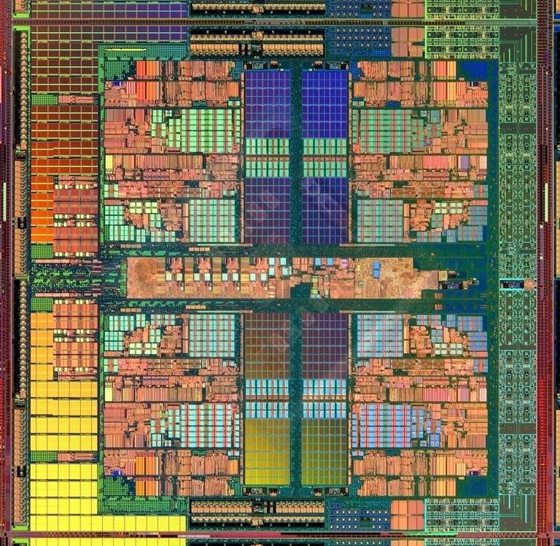
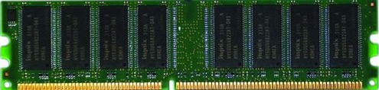
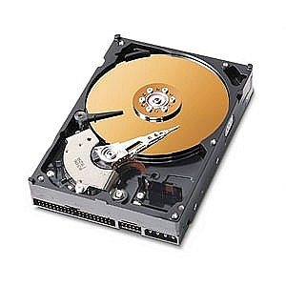
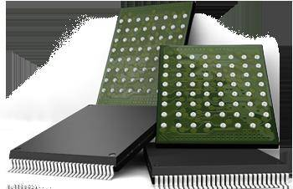
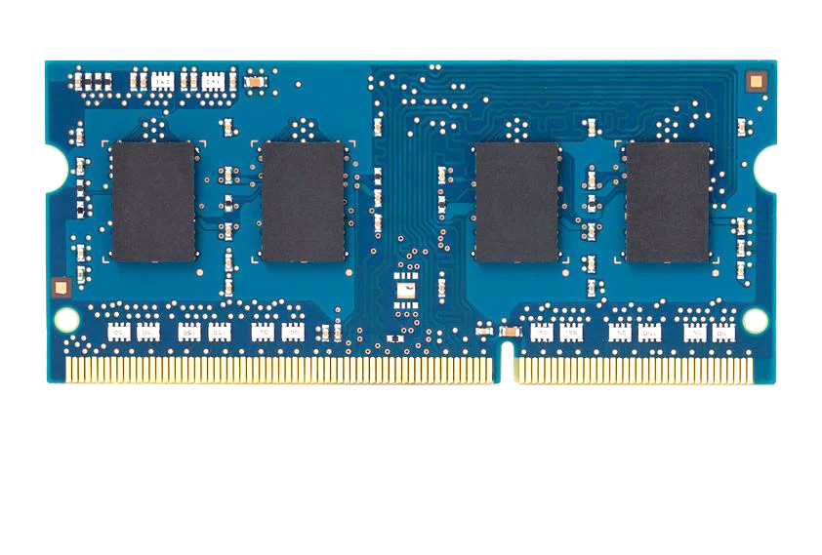
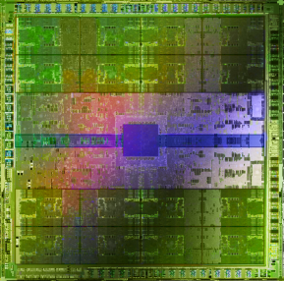
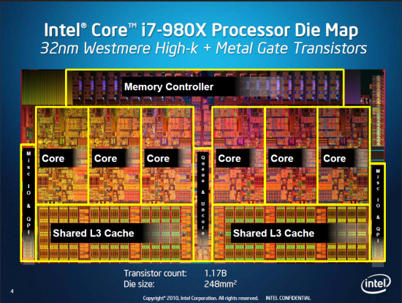
Current Research Focus Areas
Research Focus: Computer architecture, HW/SW, bioinformatics, security
Memory and storage (DRAM, flash, emerging), interconnects
Heterogeneous & parallel systems, GPUs, systems for data analytics
System/architecture interaction, new execution models, new interfaces
Hardware security, energy efficiency, fault tolerance, performance
Genome sequence analysis & assembly algorithms and architectures
Biologically inspired systems & system design for bio/medicine
Hybrid Main Memory
Heterogeneous
Processors and
Accelerators
Persistent Memory/Storage
Broad research
spanning apps, systems, logic
with architecture at the center
Graphics and Vision Processing
Notes:
Professor Mutlu’s research focus is all aspects of computer architecture, HW/SW interaction and bioinformatics.
He is looking for students to perform research in these areas.
He and his group, SAFARI, solve fundamental problems spanning:
Memory, memory, memory, storage, interconnects
Parallel architectures, heterogeneous architectures, GP-GPUs
System/architecture interaction, new execution models
Energy efficiency, fault tolerance, hardware security
Genome sequence analysis and assembly
His group does broad research spanning systems to logic with architecture at center

Slide 4
Four Key Directions
Fundamentally Secure/Reliable/Safe Architectures
Fundamentally Energy-Efficient Architectures
Memory-centric (Data-centric) Architectures
Fundamentally Low-Latency and Predictable Architectures
Architectures for AI/ML, Genomics, Medicine, Health

Slide 5
What Will We Learn in This Course?

Slide 6
Answer
How Computers Work
(from the ground up)

Slide 7
Answer Continued
And Why We Care

Slide 8
Why Do We Have Computers?

Slide 9
Why Do We Do Computing?

Slide 10
Answer
To Solve Problems

Slide 11
Answer Reworded
To Gain Insight
Hamming, “Numerical Methods for Scientists and Engineers,” 1962.

Slide 12
Answer Extended
To Enable
a Better Life & Future

Slide 13
How Does a Computer Solve Problems?

Slide 14
Answer
Orchestrating Electrons
In today’s dominant technologies

Slide 15
How Do Problems Get Solved by Electrons?

Slide 16
The Transformation Hierarchy
Problem
Algorithm
Program/Language
System Software
Computer Architecture (expanded view)
SW/HW Interface
Computer Architecture (narrow view)
Micro-architecture
Logic
Devices
Electrons

Slide 17
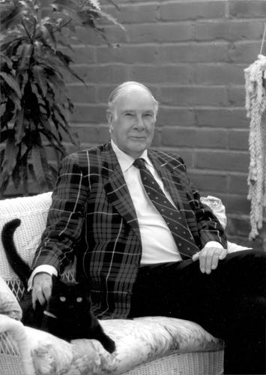
Levels of Transformation
“The purpose of computing is [to gain] insight” (Richard Hamming)
We gain and generate insight by solving problems
How do we ensure problems are solved by electrons?
Algorithm
Step-by-step procedure that is guaranteed to terminate where each step is precisely stated and can be carried out by a computer
Finiteness
Definiteness
Effective computability
Many algorithms for the same
problem
Problem
Algorithm
Program/Language
Runtime System
(VM, OS, MM)
ISA
(Instruction Set Architecture)
Interface/contract between SW and HW.
What the programmer assumes hardware will satisfy.
ISA (Architecture)
Microarchitecture
Logic
Devices
Electrons
Microarchitecture
An implementation of the ISA
Digital logic circuits
Building blocks of micro-arch (e.g., gates)
Notes:
ISA is the interface between hardware and software… It is a contract that the hardware promises to satisfy.
Algorithm: step by step procedure where each step is effectively computable (by a computer), is definite (precisely defined) – “do until fast” is not definite, and terminates
Hamming distance: number of locations in which the corresponding symbols of two equal-length strings is different
Hamming, Richard W. (1950), "Error detecting and error correcting codes", Bell System Technical Journal 29 (2): 147–160
Hamming codes

Slide 18
Computer Architecture
is the science and art of designing computing platforms (hardware, interface, system SW, and programming model)
to achieve a set of design goals
E.g., highest performance on earth on workloads X, Y, Z
E.g., longest battery life at a form factor that fits in your pocket with cost < $$$ CHF
E.g., best average performance across all known workloads at the best performance/cost ratio
…
Designing a supercomputer is different from designing a smartphone → But, many fundamental principles are similar

Slide 19
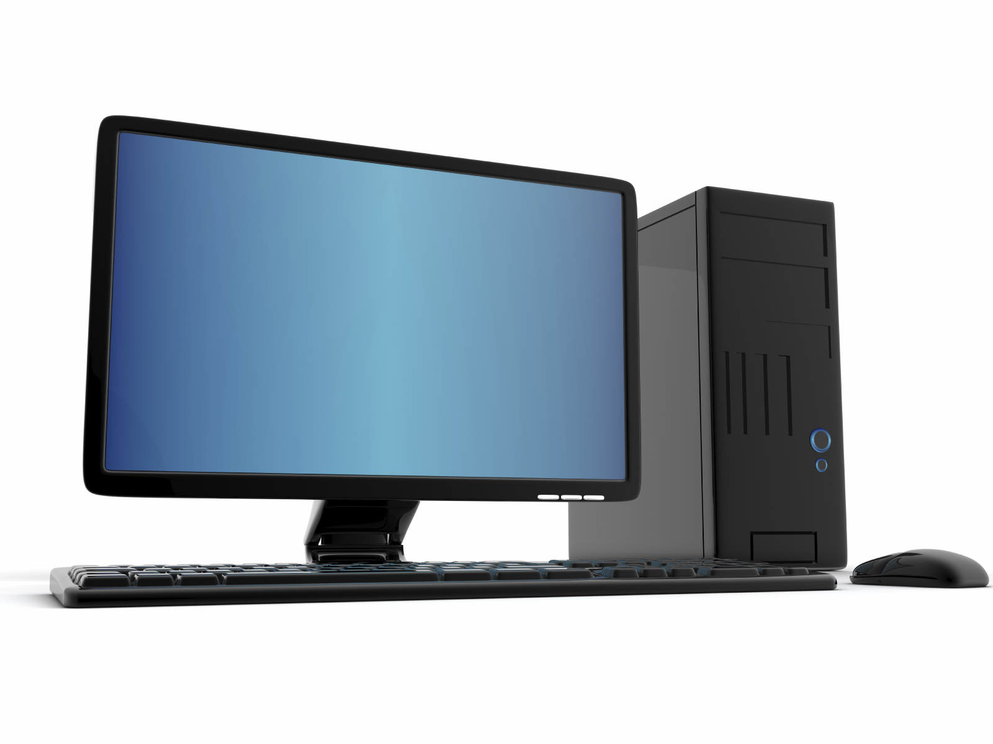
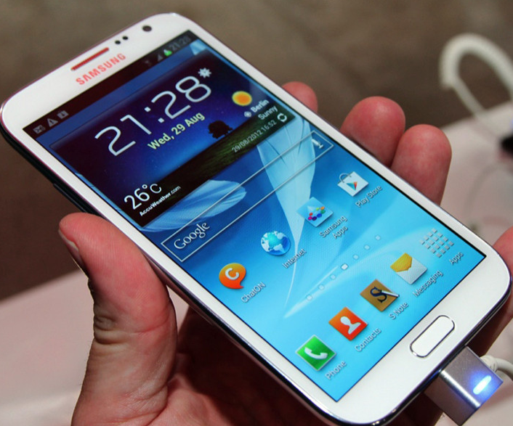
Different Platforms, Different Goals
Source: http://www.sia-online.org (semiconductor industry association)

Slide 20
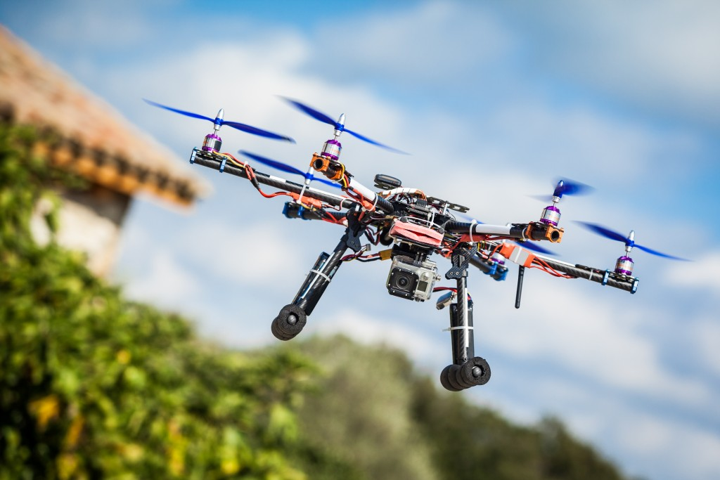
Different Platforms, Different Goals
Source: https://iq.intel.com/5-awesome-uses-for-drone-technology/

Slide 21
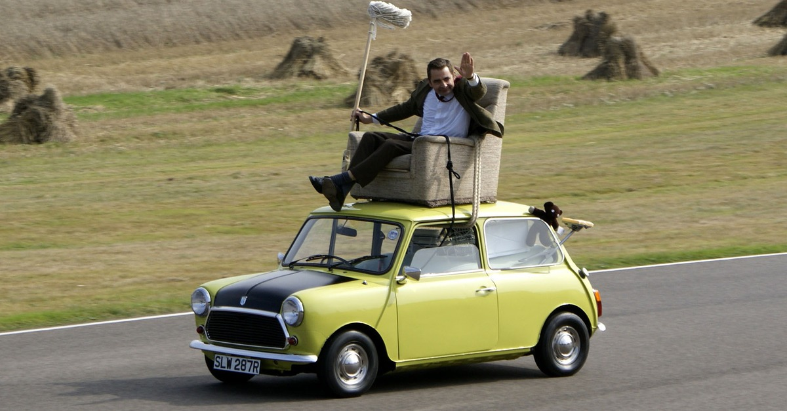
Different Platforms, Different Goals
Source: https://taxistartup.com/wp-content/uploads/2015/03/UK-Self-Driving-Cars.jpg

Slide 22
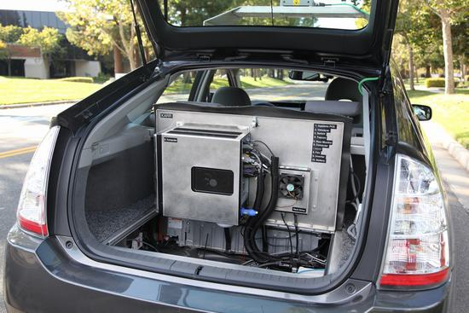
Different Platforms, Different Goals
Source: http://sm.pcmag.com/pcmag_uk/photo/g/google-self-driving-car-the-guts/google-self-driving-car-the-guts_dwx8.jpg

Slide 23
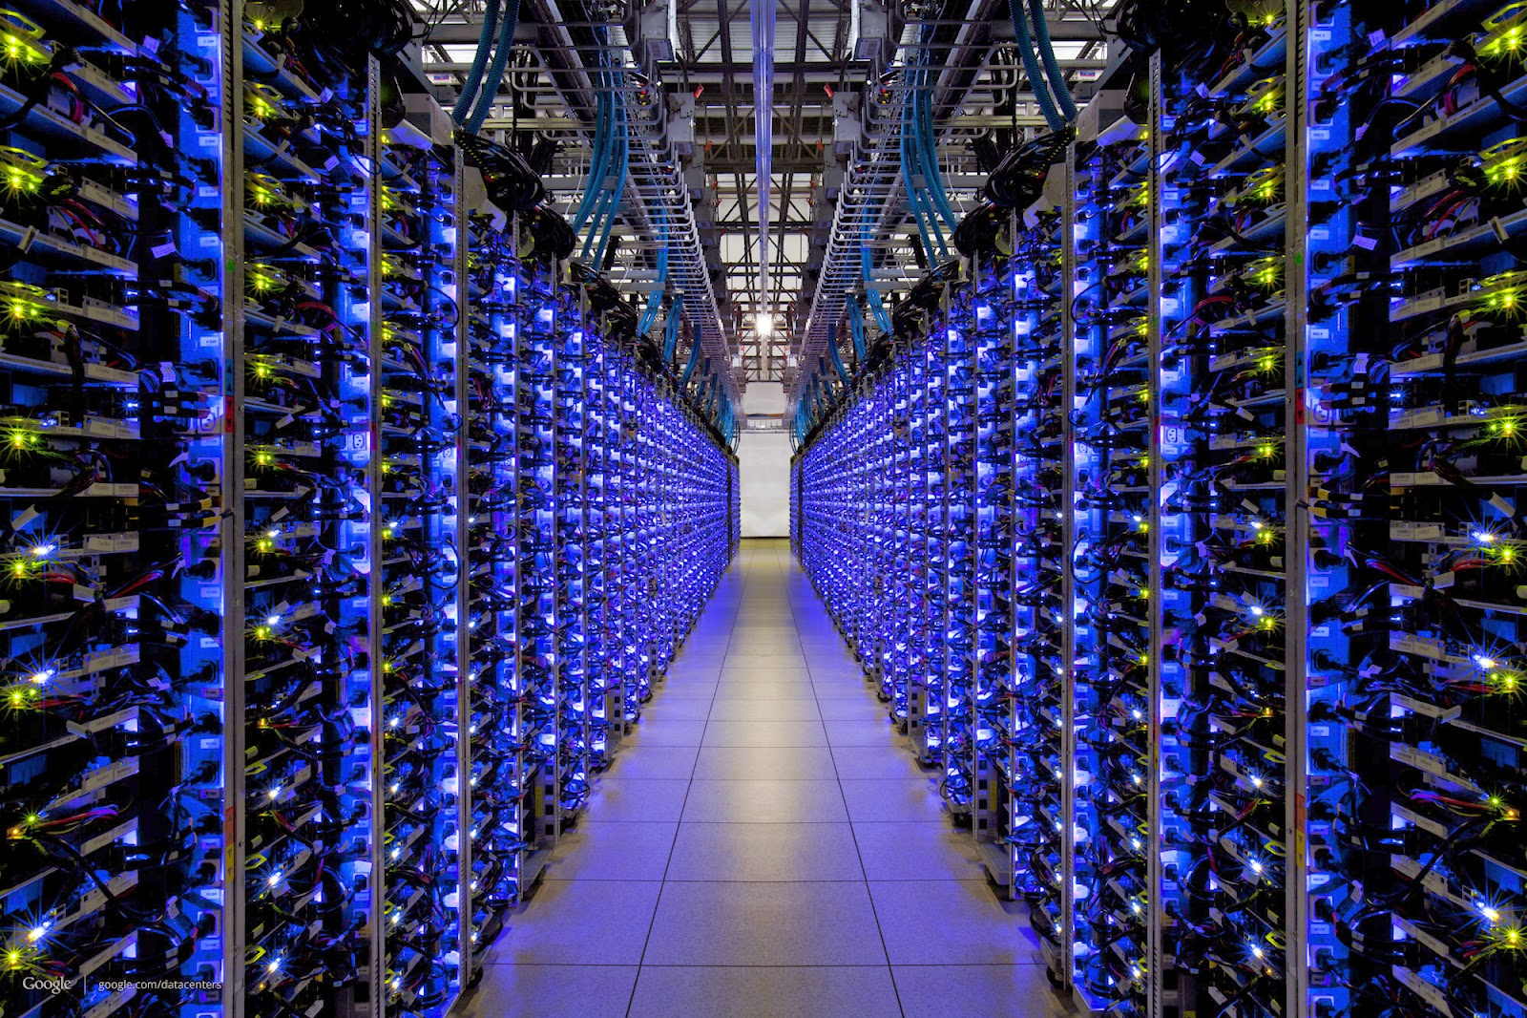
Different Platforms, Different Goals
Source: http://datacentervoice.com/wp-content/uploads/2015/10/data-center.jpg

Slide 24
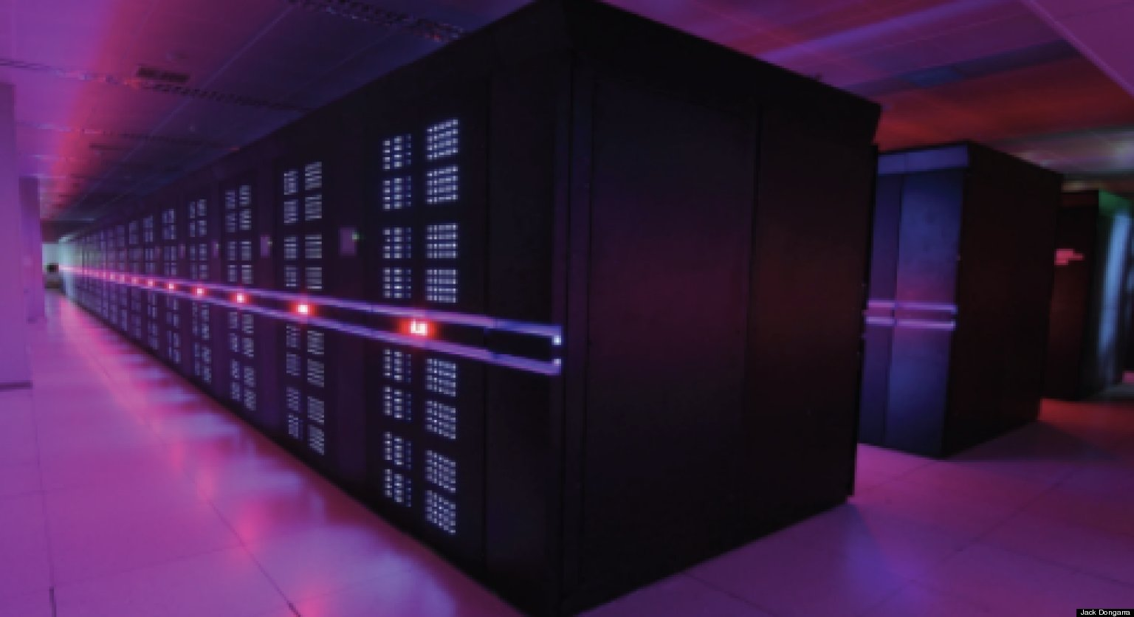
Different Platforms, Different Goals
Source: https://fossbytes.com/wp-content/uploads/2015/06/Supercomputer-TIANHE2-china.jpg

Slide 25
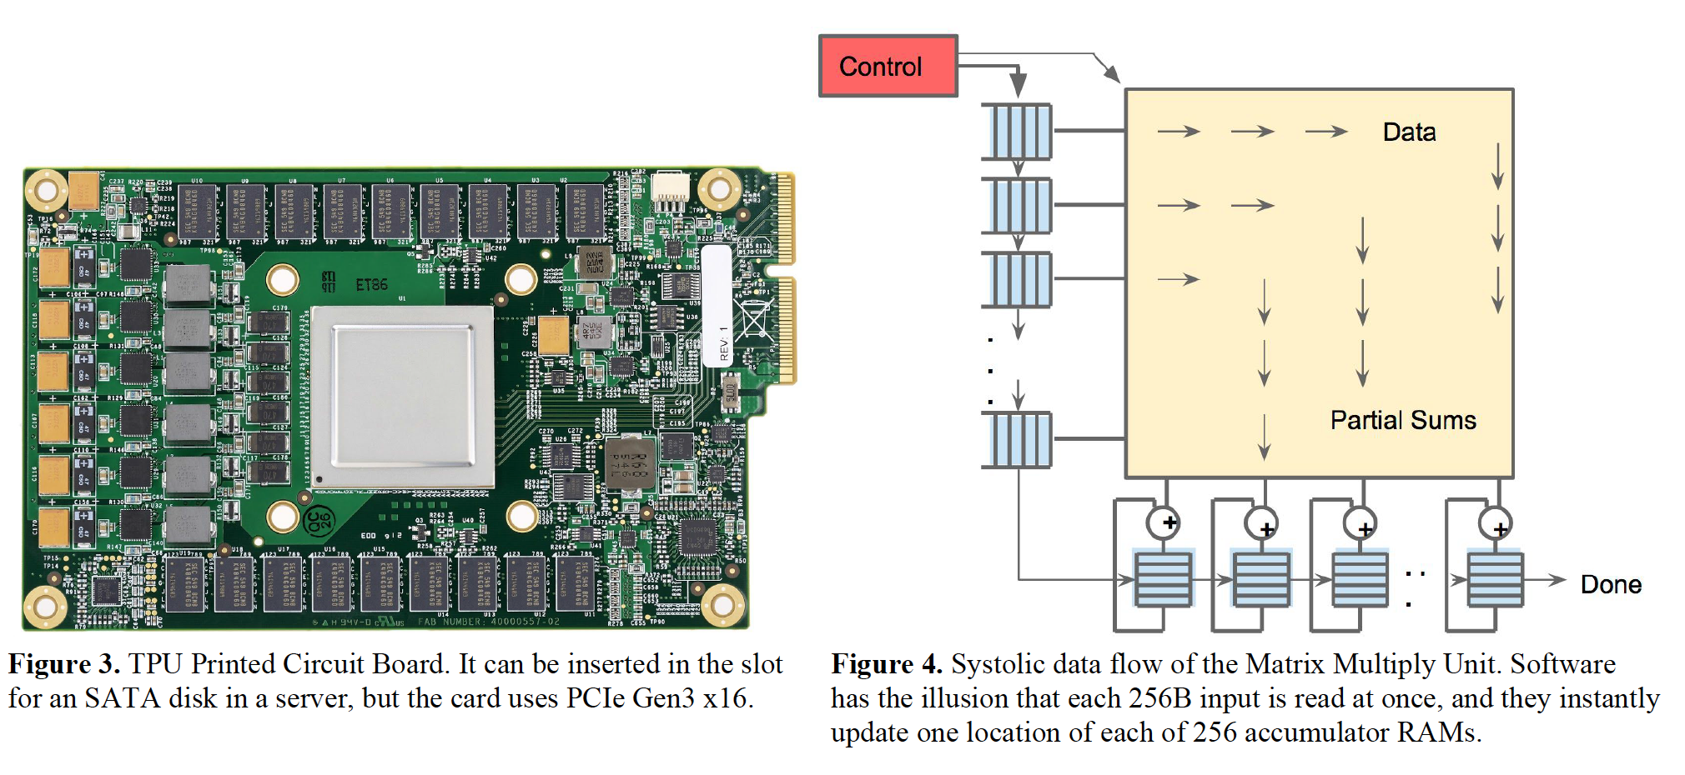
Different Platforms, Different Goals
Jouppi et al., “In-Datacenter Performance Analysis of a Tensor Processing Unit”, ISCA 2017.

Slide 26
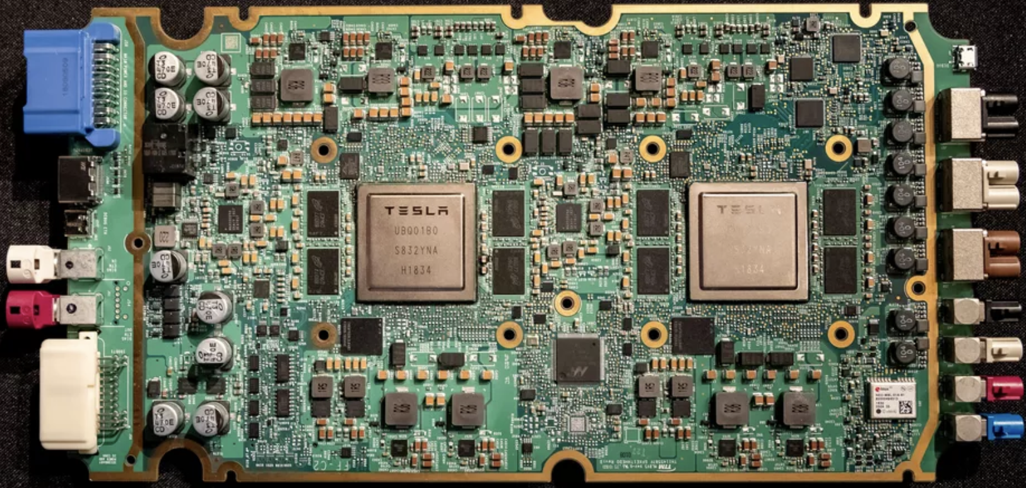
Different Platforms, Different Goals
ML accelerator: 260 mm², 6 billion transistors, 600 GFLOPS GPU, 12 ARM 2.2 GHz CPUs.
Two redundant chips for better safety.
https://youtu.be/Ucp0TTmvqOE?t=4236

Slide 27
Axiom
To achieve the highest energy efficiency and performance:
we must take the expanded view
of computer architecture
Problem
Algorithm
Program/Language
System Software
Co-design across the hierarchy:
Algorithms to devices
SW/HW Interface
Micro-architecture
Logic
Specialize as much as possible
within the design goals
Devices
Electrons

Slide 28
Many Interesting Things Are Happening Today in Computer Architecture

Slide 29
Many Interesting Things Are Happening Today in Computer Architecture
Performance
and
Energy Efficiency

Slide 30
Intel Optane Persistent Memory (2019)
Non-volatile main memory
Based on 3D-XPoint Technology
https://www.storagereview.com/intel_optane_dc_persistent_memory_module_pmm

Slide 31
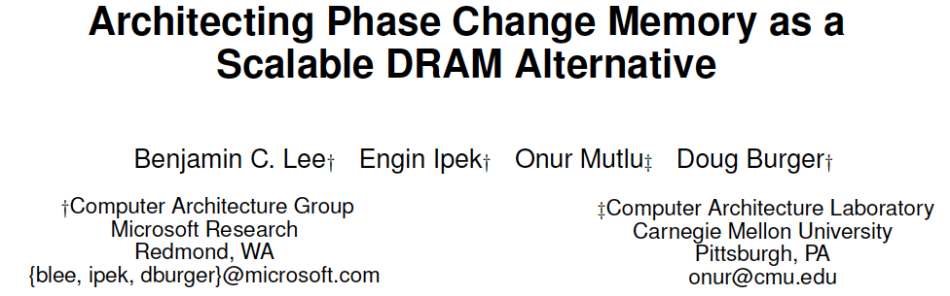
PCM as Main Memory: Idea in 2009
Benjamin C. Lee, Engin Ipek, Onur Mutlu, and Doug Burger, "Architecting Phase Change Memory as a Scalable DRAM Alternative" Proceedings of the 36th International Symposium on Computer Architecture (ISCA), pages 2-13, Austin, TX, June 2009. Slides (pdf)

Slide 32
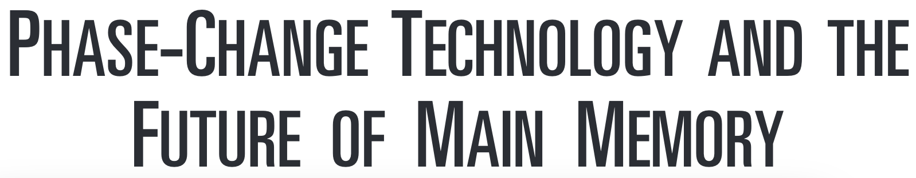
PCM as Main Memory: Idea in 2009
Benjamin C. Lee, Ping Zhou, Jun Yang, Youtao Zhang, Bo Zhao, Engin Ipek, Onur Mutlu, and Doug Burger, "Phase Change Technology and the Future of Main Memory" IEEE Micro, Special Issue: Micro's Top Picks from 2009 Computer Architecture Conferences (MICRO TOP PICKS), Vol. 30, No. 1, pages 60-70, January/February 2010.

Slide 33
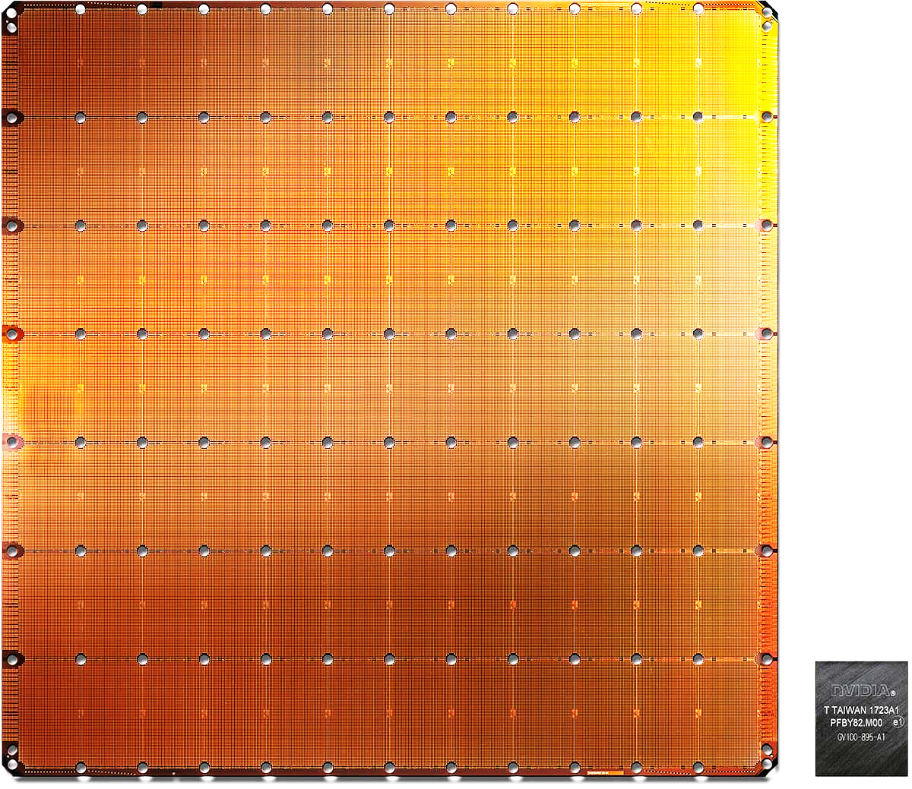
Cerebras’s Wafer Scale Engine (2019)
The largest ML
accelerator chip
400,000 cores
Cerebras WSE
1.2 Trillion transistors
46,225 mm²
Largest GPU
21.1 Billion transistors
815 mm²
NVIDIA TITAN V
https://www.anandtech.com/show/14758/hot-chips-31-live-blogs-cerebras-wafer-scale-deep-learning
https://www.cerebras.net/cerebras-wafer-scale-engine-why-we-need-big-chips-for-deep-learning/
Notes:
The Wafer-Scale Engine is the most massive AI chip ever produced and packs a whopping 400,000 cores in a 46,225mm2 footprint.

Slide 34
UPMEM Processing-in-DRAM Engine (2019)
Processing in DRAM Engine
Includes standard DIMM modules, with a large number of DPU processors combined with DRAM chips.
Replaces standard DIMMs
DDR4 R-DIMM modules
8GB+128 DPUs (16 PIM chips)
Standard 2x-nm DRAM process
Large amounts of compute & memory bandwidth
https://www.anandtech.com/show/14750/hot-chips-31-analysis-inmemory-processing-by-upmem
https://www.upmem.com/video-upmem-presenting-its-true-processing-in-memory-solution-hot-chips-2019/

Slide 35
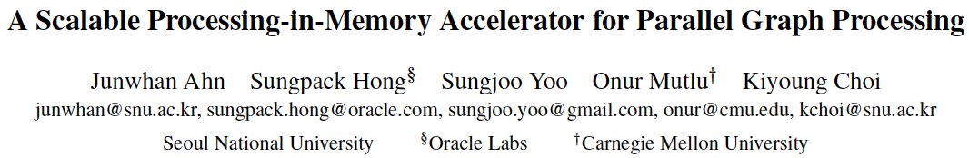
Specialized Processing in Memory (2015)
Junwhan Ahn, Sungpack Hong, Sungjoo Yoo, Onur Mutlu, and Kiyoung Choi, "A Scalable Processing-in-Memory Accelerator for Parallel Graph Processing" Proceedings of the 42nd International Symposium on Computer Architecture (ISCA), Portland, OR, June 2015. [Slides (pdf)] [Lightning Session Slides (pdf)]

Slide 36
Processing in Memory on Mobile Devices
Amirali Boroumand, Saugata Ghose, Youngsok Kim, Rachata Ausavarungnirun, Eric Shiu, Rahul Thakur, Daehyun Kim, Aki Kuusela, Allan Knies, Parthasarathy Ranganathan, and Onur Mutlu, "Google Workloads for Consumer Devices: Mitigating Data Movement Bottlenecks" Proceedings of the 23rd International Conference on Architectural Support for Programming Languages and Operating Systems (ASPLOS), Williamsburg, VA, USA, March 2018.

Slide 37
TESLA Full Self-Driving Computer (2019)
ML accelerator: 260 mm², 6 billion transistors, 600 GFLOPS GPU, 12 ARM 2.2 GHz CPUs.
Two redundant chips for better safety.
https://youtu.be/Ucp0TTmvqOE?t=4236

Slide 38
Google TPU Generation I (~2016)
Jouppi et al., “In-Datacenter Performance Analysis of a Tensor Processing Unit”, ISCA 2017.

Slide 39
Google TPU Generation II (2017)
4 TPU chips
vs 1 chip in TPU1
High Bandwidth Memory
vs DDR3
Floating point operations
vs FP16
45 TFLOPS per chip
vs 23 TOPS
https://www.nextplatform.com/2017/05/17/first-depth-look-googles-new-second-generation-tpu/
Designed for training
and inference
vs only inference

Slide 40
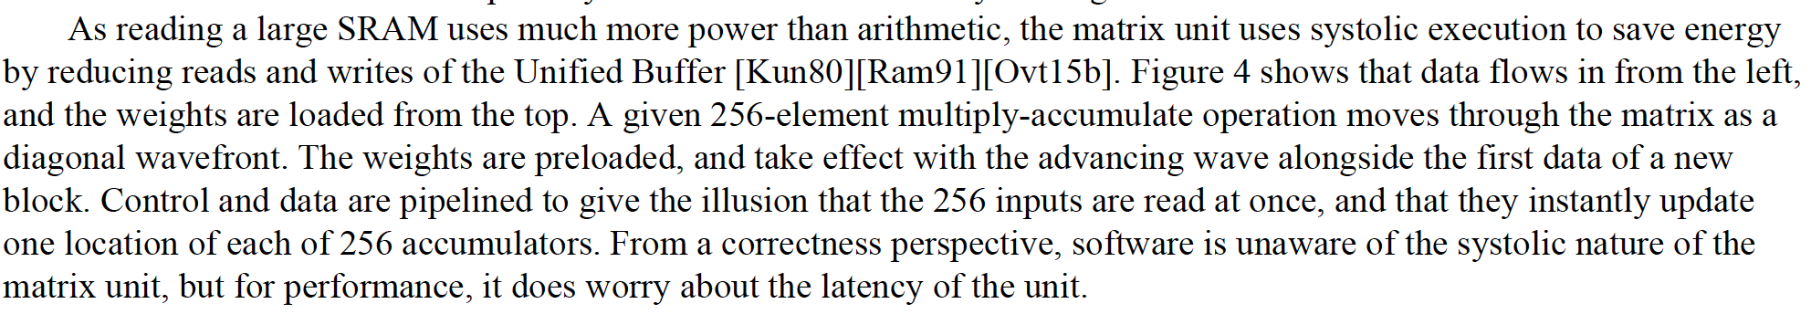
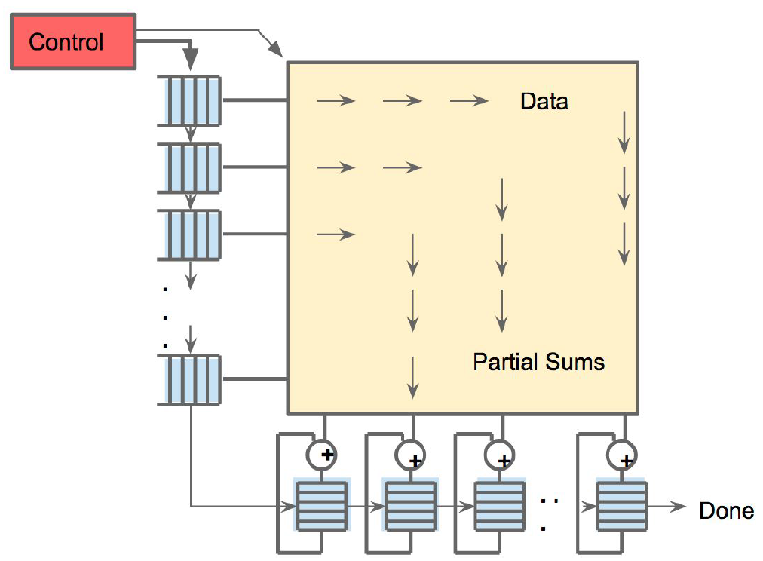
An Example Modern Systolic Array: TPU (II)
Jouppi et al., “In-Datacenter Performance Analysis of a Tensor Processing Unit”, ISCA 2017.

Slide 41
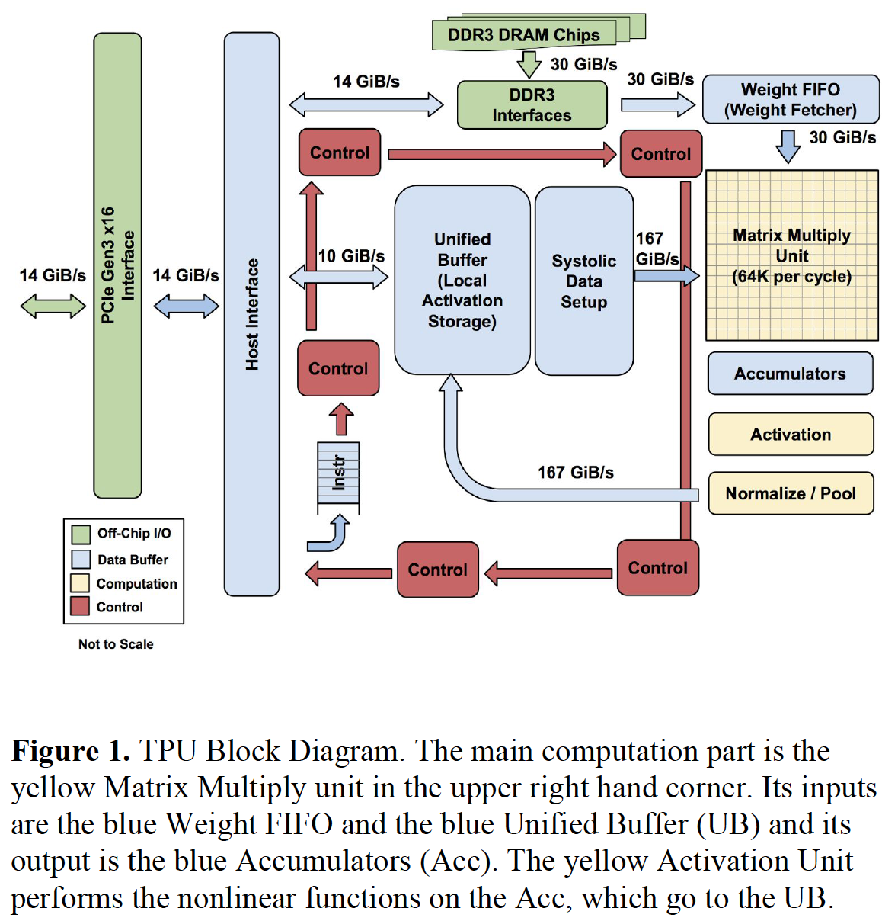
An Example Modern Systolic Array: TPU (III)

Slide 42
Many (Other) AI/ML Chips
Alibaba
Amazon
Facebook
Google
Huawei
Intel
Microsoft
NVIDIA
Tesla
Many Others and Many Startups…
Many More to Come…

Slide 43
Many (Other) AI/ML Chips
Alibaba
Amazon
Facebook
Google
Huawei
Microsoft
NVIDIA
Tesla
Many Startups…
Many More to Come…
https://basicmi.github.io/AI-Chip/

Slide 44
Many Interesting Things Are Happening Today in Computer Architecture

Slide 45
Many Interesting Things Are Happening Today in Computer Architecture
Reliability
and
Security

Slide 46
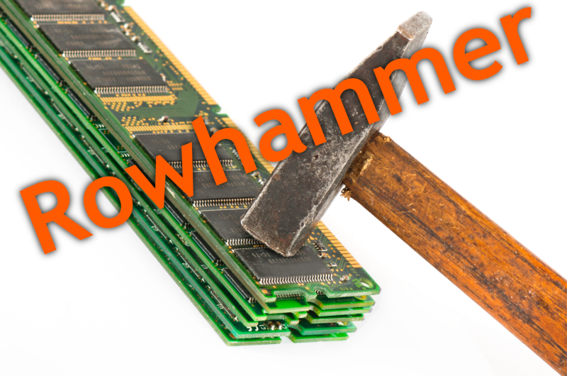
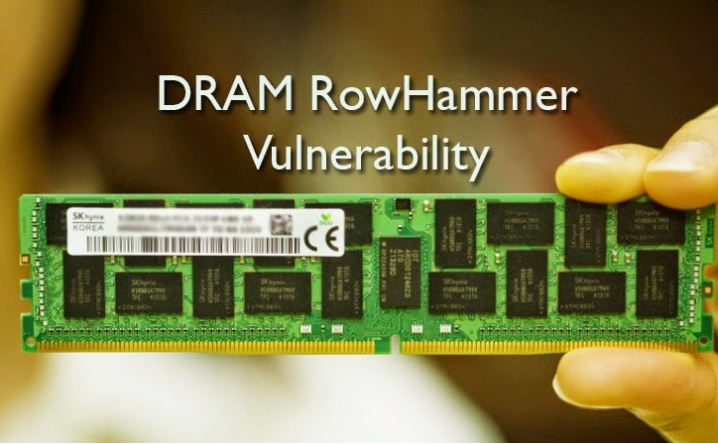
Security: RowHammer (2014)
Notes:
Picture from the article:
http://thehackernews.com/2015/03/dram-rowhammer-vulnerability.html

Slide 47
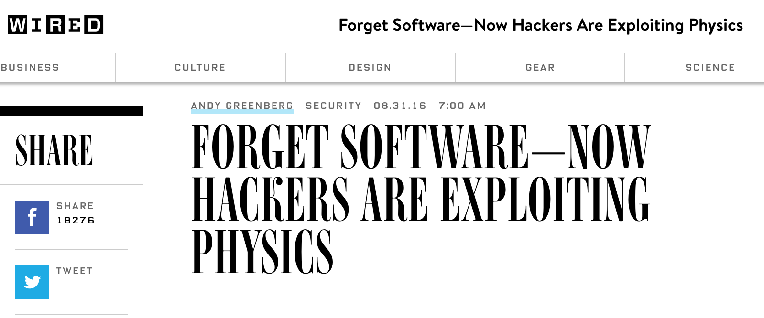
The Story of RowHammer
One can predictably induce bit flips in commodity DRAM chips
>80% of the tested DRAM chips are vulnerable
First example of how a simple hardware failure mechanism can create a widespread system security vulnerability

Slide 48
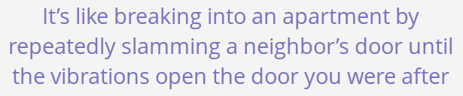
Security: RowHammer (2014)
Notes:
Picture from the article:
http://thehackernews.com/2015/03/dram-rowhammer-vulnerability.html

Slide 49
Modern DRAM is Prone to Disturbance Errors
Row of Cells
Wordline
Row
Victim Row
Row
Hammered Row
V_{LOW}
Opened
V_{HIGH}
Closed
Row
Victim Row
Row
Repeatedly reading a row enough times (before memory gets refreshed) induces disturbance errors in adjacent rows in most real DRAM chips you can buy today
Flipping Bits in Memory Without Accessing Them: An Experimental Study of DRAM Disturbance Errors, (Kim et al., ISCA 2014)

Slide 50
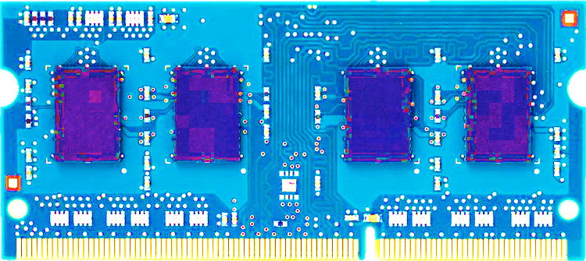
Most DRAM Modules Are Vulnerable
A company
B company
C company
86%
(37/43)
83%
(45/54)
88%
(28/32)
Up to
1.0×10⁷ errors
Up to
2.7×10⁶ errors
Up to
3.3×10⁵ errors
Flipping Bits in Memory Without Accessing Them: An Experimental Study of DRAM Disturbance Errors, (Kim et al., ISCA 2014)

Slide 51
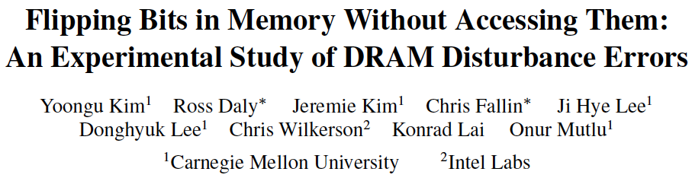
RowHammer: Five Years Ago…
Yoongu Kim, Ross Daly, Jeremie Kim, Chris Fallin, Ji Hye Lee, Donghyuk Lee, Chris Wilkerson, Konrad Lai, and Onur Mutlu, "Flipping Bits in Memory Without Accessing Them: An Experimental Study of DRAM Disturbance Errors" Proceedings of the 41st International Symposium on Computer Architecture (ISCA), Minneapolis, MN, June 2014. [Slides (pptx) (pdf)] [Lightning Session Slides (pptx) (pdf)] [Source Code and Data]

Slide 52
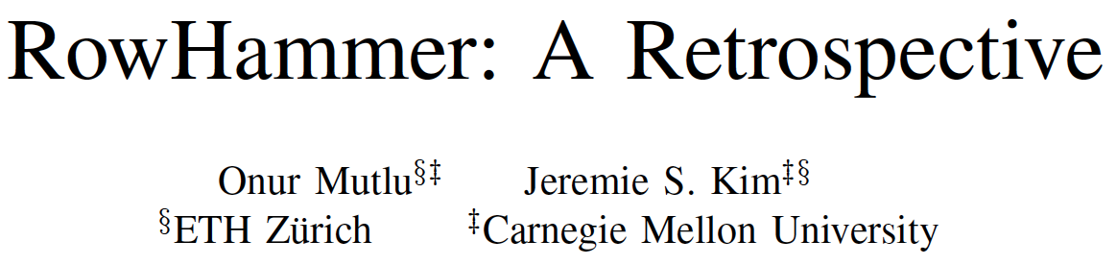
RowHammer: Now and Beyond…
Onur Mutlu and Jeremie Kim, "RowHammer: A Retrospective" IEEE Transactions on Computer-Aided Design of Integrated Circuits and Systems (TCAD) Special Issue on Top Picks in Hardware and Embedded Security, 2019. [Preliminary arXiv version]

Slide 53
Security: Meltdown and Spectre (2018)
Source: J. Masters, Redhat, FOSDEM 2018 keynote talk.

Slide 54
Meltdown and Spectre
Someone can steal secret data from the system even though
your program and data are perfectly correct and
your hardware behaves according to the specification and
there are no software vulnerabilities/bugs
Why?
Speculative execution leaves traces of secret data in the processor’s cache (internal storage)
It brings data that is not supposed to be brought/accessed if there was no speculative execution
A malicious program can inspect the contents of the cache to “infer” secret data that it is not supposed to access
A malicious program can actually force another program to speculatively execute code that leaves traces of secret data

Slide 55
More on Meltdown/Spectre Vulnerabilities
Source: https://googleprojectzero.blogspot.ch/2018/01/reading-privileged-memory-with-side.html

Slide 56
Many Interesting Things Are Happening Today in Computer Architecture

Slide 57
Many Interesting Things Are Happening Today in Computer Architecture
More Demanding Workloads

Slide 58
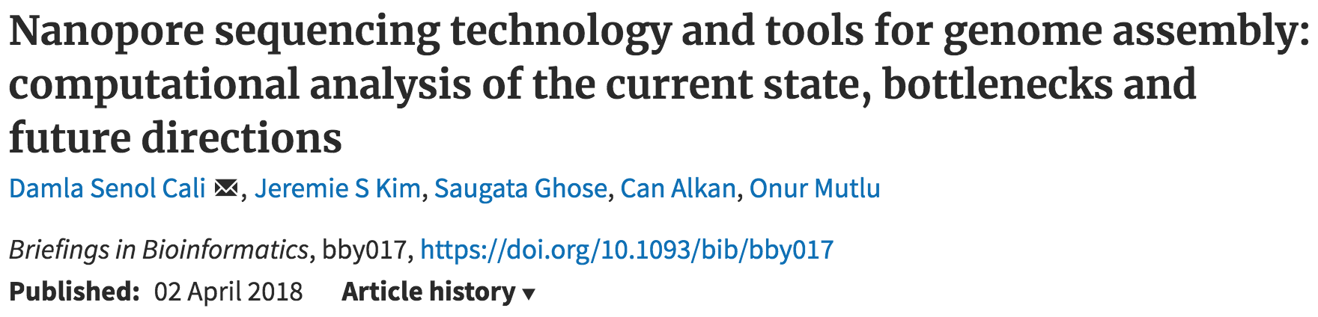
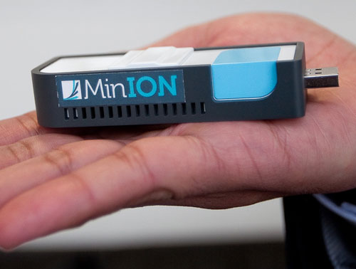
New Genome Sequencing Technologies
Oxford Nanopore MinION
Senol Cali+, “Nanopore Sequencing Technology and Tools for Genome
Assembly: Computational Analysis of the Current State, Bottlenecks
and Future Directions,” Briefings in Bioinformatics, 2018.
[Preliminary arxiv.org version]
Data → performance & energy bottleneck

Slide 59
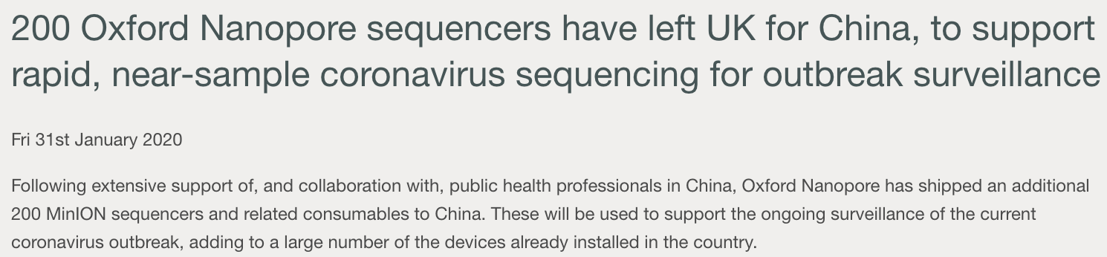
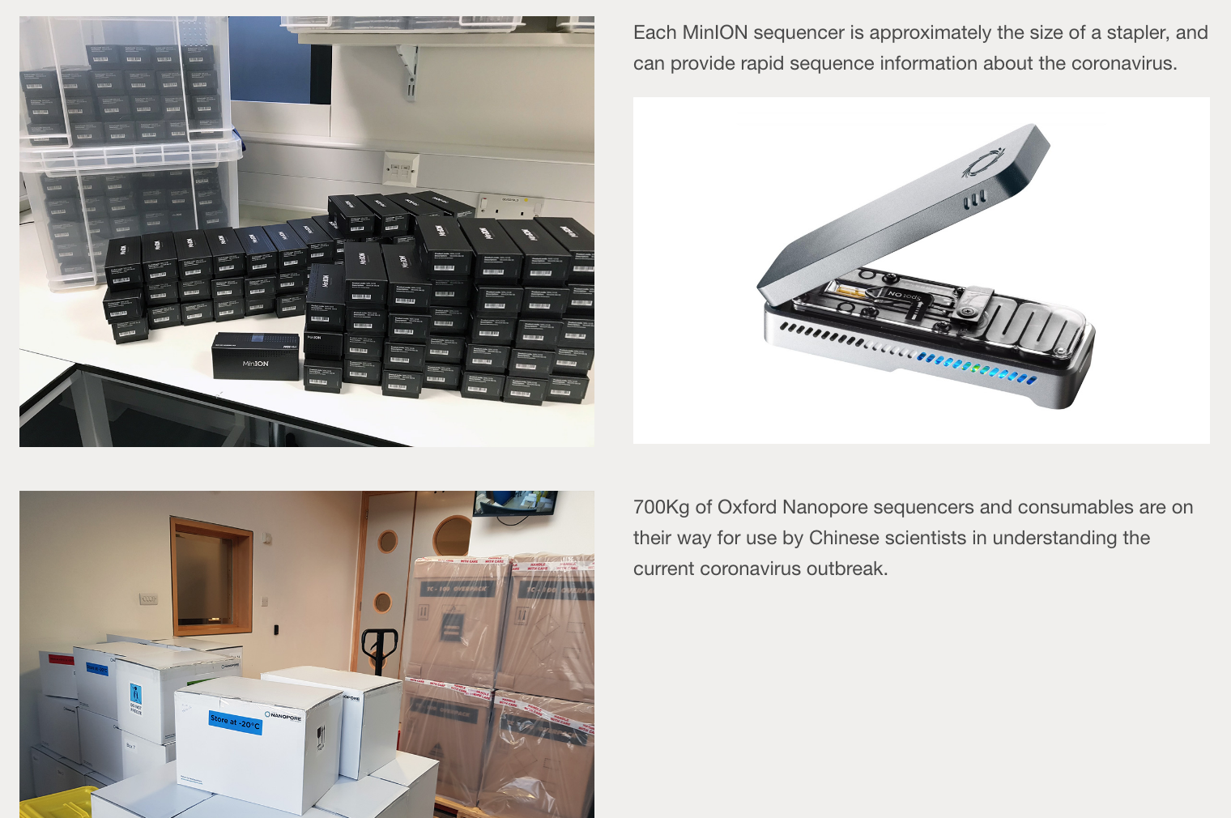
Why Do We Care? An Example
Source: https://nanoporetech.com/about-us/news/200-oxford-nanopore-sequencers-have-left-uk-china-support-rapid-near-sample

Slide 60
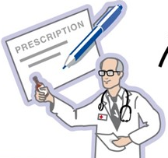
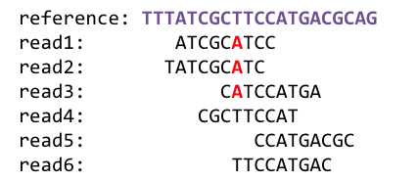
1
Sequencing
Genome Analysis
Read Mapping
2
Data → performance & energy bottleneck
Variant Calling
Scientific Discovery
3
4
Notes:
Genome analysis starts with sequencing random short DNA fragments of copies of the original molecule.
Unfortunately, these reads lack information about their order and which part of genome they are originated from.
Hence the second step is to map these reads to a long reference genome.

Slide 61
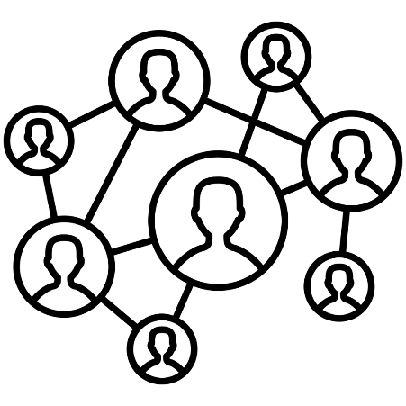



Data Overwhelms Modern Machines
In-memory Databases
[Mao+, EuroSys’12; Clapp+ (Intel), IISWC’15]
Graph/Tree Processing
[Xu+, IISWC’12; Umuroglu+, FPL’15]
Data → performance & energy bottleneck
In-Memory Data Analytics
[Clapp+ (Intel), IISWC’15;
Awan+, BDCloud’15]
Datacenter Workloads [Kanev+ (Google), ISCA’15]

Slide 62






Data Overwhelms Modern Machines
Chrome
TensorFlow Mobile
Google’s web browser
Google’s machine learning framework
Data → performance & energy bottleneck
Video Playback
Video Capture
Google’s video codec
Google’s video codec
Notes:
In this work, we take a look at widely-used google consumer workloads, to figure out the major sources of energy consumption.
We look at Google Chrome web brower. We take a look at Tensorflow, Google’s machine learning framework, and we also take a look at two important video related workloads, video playback and video capture, both rely on Google’s vp9 codec technology.

Slide 63
Data Movement Overwhelms Modern Machines
Amirali Boroumand, Saugata Ghose, Youngsok Kim, Rachata Ausavarungnirun, Eric Shiu, Rahul Thakur, Daehyun Kim, Aki Kuusela, Allan Knies, Parthasarathy Ranganathan, and Onur Mutlu, "Google Workloads for Consumer Devices: Mitigating Data Movement Bottlenecks" Proceedings of the 23rd International Conference on Architectural Support for Programming Languages and Operating Systems (ASPLOS), Williamsburg, VA, USA, March 2018.
62.7% of the total system energy
is spent on data movement

Slide 64
Many Interesting Things Are Happening Today in Computer Architecture

Slide 65
Many Novel Concepts Investigated Today
New Computing Paradigms (Rethinking the Full Stack)
Processing in Memory, Processing Near Data
Neuromorphic Computing
Fundamentally Secure and Dependable Computers
New Accelerators (Algorithm-Hardware Co-Designs)
Artificial Intelligence & Machine Learning
Graph Analytics
Genome Analysis
New Memories and Storage Systems
Non-Volatile Main Memory
Intelligent Memory

Slide 66
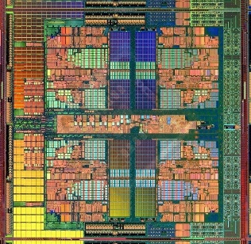

Computer Architecture Today
Computing landscape is very different from 10-20 years ago
Applications and technology both demand novel architectures
Hybrid Main Memory
Heterogeneous
Processors and
Accelerators
Persistent Memory/Storage
Every component and its
interfaces, as well as
entire system designs
are being re-examined
General Purpose GPUs

Slide 67
Computer Architecture Today (II)
You can revolutionize the way computers are built, if you understand both the hardware and the software (and change each accordingly)
You can invent new paradigms for computation, communication, and storage
Recommended book: Thomas Kuhn, “The Structure of Scientific Revolutions” (1962)
Pre-paradigm science: no clear consensus in the field
Normal science: dominant theory used to explain/improve things (business as usual); exceptions considered anomalies
Revolutionary science: underlying assumptions re-examined

Slide 68

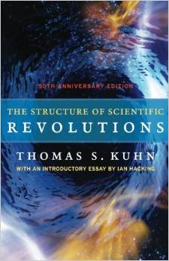
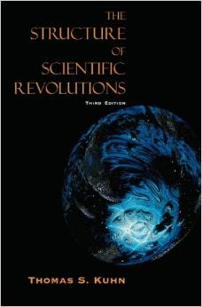
Computer Architecture Today (II)
You can revolutionize the way computers are built, if you understand both the hardware and the software (and change each accordingly)
You can invent new paradigms for computation, communication, and storage
Recommended book: Thomas Kuhn, “The Structure of Scientific Revolutions” (1962)
Pre-paradigm science: no clear consensus in the field
Normal science: dominant theory used to explain/improve things (business as usual); exceptions considered anomalies
Revolutionary science: underlying assumptions re-examined

Slide 69
Takeaways
It is an exciting time to be understanding and designing computing architectures
Many challenging and exciting problems in platform design
That no one has tackled (or thought about) before
That can have huge impact on the world’s future
Driven by huge hunger for data (Big Data), new applications (ML/AI, graph analytics, genomics), ever-greater realism, …
We can easily collect more data than we can analyze/understand
Driven by significant difficulties in keeping up with that hunger at the technology layer
Five walls: Energy, reliability, complexity, security, scalability

Slide 70
Let’s Start with Some Puzzles
a.k.a. Computer Architecture resembles Building Architecture

Slide 71
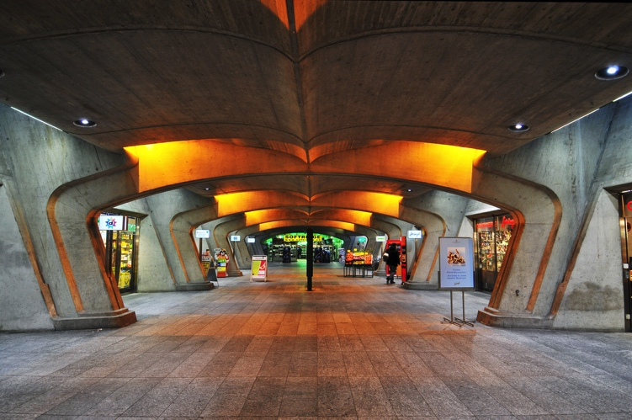
What Is This?
Source: https://www.flickr.com/photos/tambako/2286064777/in/photostream/

Slide 72
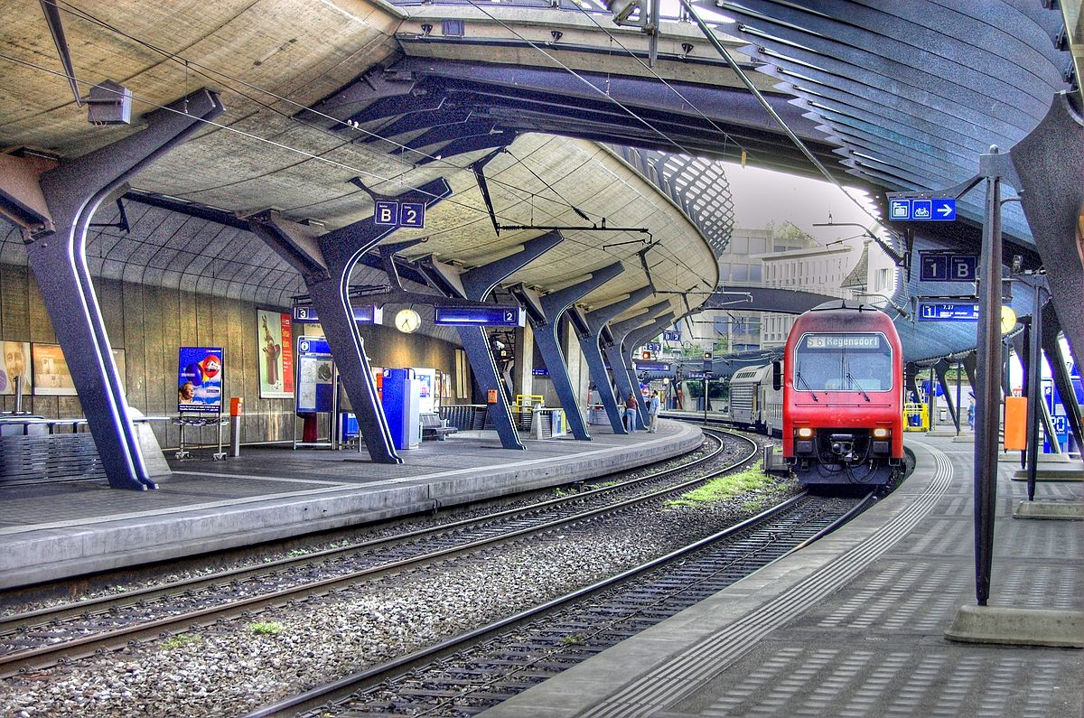
What About This?
Source: By Toni_V, CC BY-SA 2.0, https://commons.wikimedia.org/w/index.php?curid=4087256

Slide 73
What Do the Following Have in Common?

Slide 74
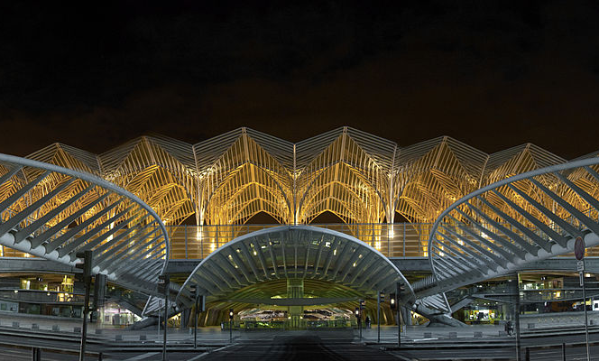
Gare do Oriente, Lisbon
Source: By Martín Gómez Tagle - Lisbon, Portugal, CC BY-SA 3.0, https://commons.wikimedia.org/w/index.php?curid=13764903

Slide 75
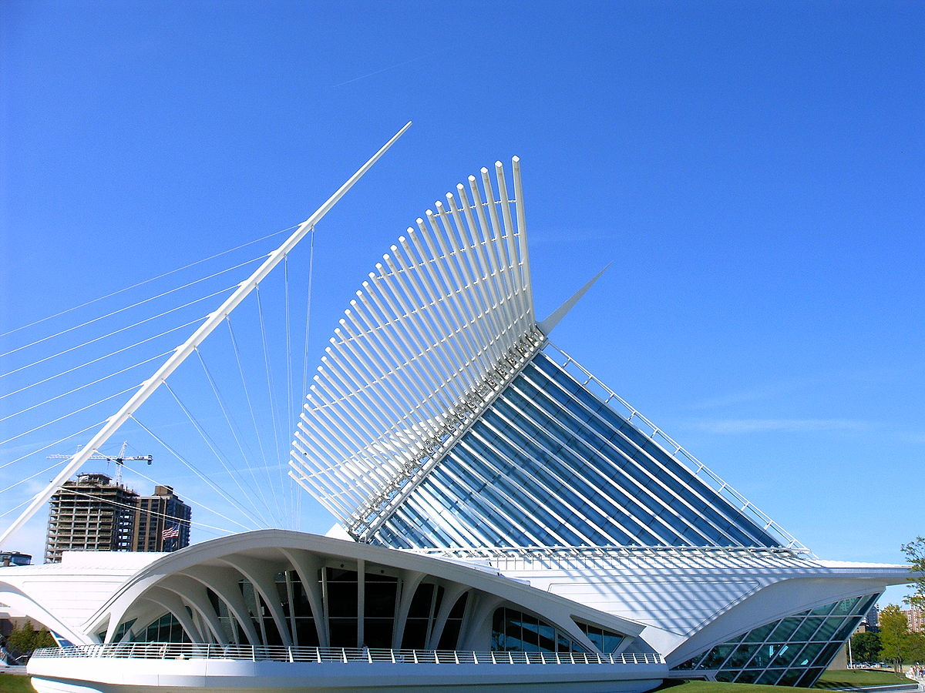
Milwaukee Art Museum
Source: By Andrew C. from Flagstaff, USA - Flickr, CC BY 2.0, https://commons.wikimedia.org/w/index.php?curid=379223

Slide 76
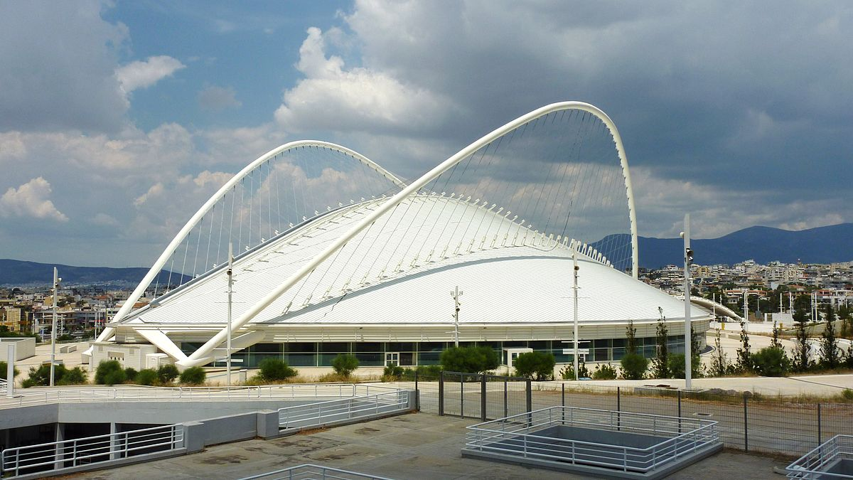
Athens Olympic Stadium
Source: By Spyrosdrakopoulos - Own work, CC BY-SA 3.0, https://commons.wikimedia.org/w/index.php?curid=16172519

Slide 77
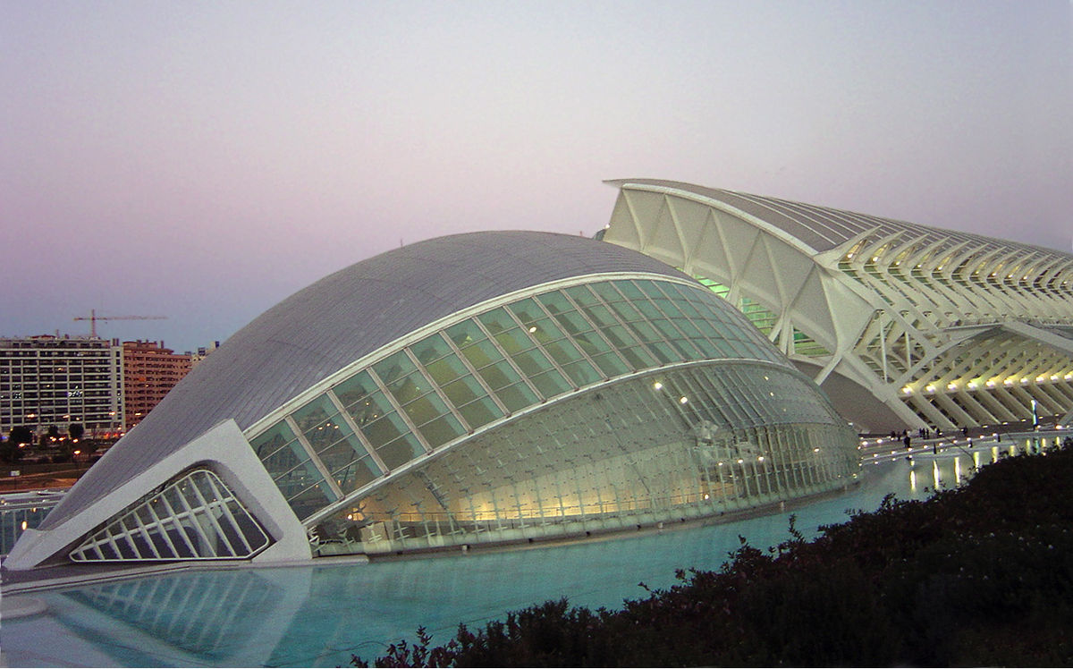
City of Arts and Sciences, Valencia
Source: CC BY-SA 3.0, https://commons.wikimedia.org/w/index.php?curid=172107

Slide 78
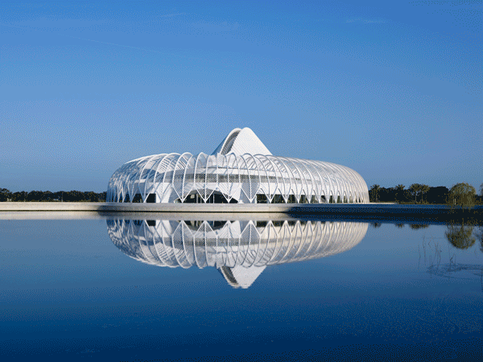
Florida Polytechnic University (I)
Source: http://www.architectmagazine.com/design/buildings/florida-polytechnic-university-designed-by-santiago-calatrava_o

Slide 79
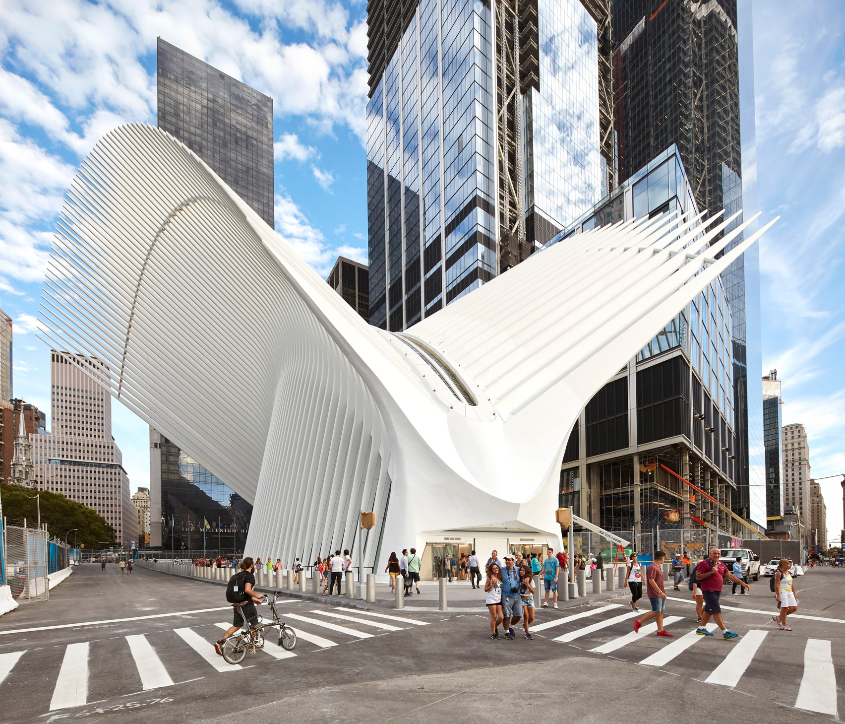
Oculus, New York City
Source: https://www.dezeen.com/2016/08/29/santiago-calatrava-oculus-world-trade-center-transportation-hub-new-york-photographs-hufton-crow/

Slide 80
What do All Those Have in Common with Bahnhof Stadelhofen?

Slide 81


Answer: All Designed by a Famous Architect
ETH Alumnus, PhD Civil Engineering
“The train station has several of the features that became signatures of his work; straight lines and right angles are rare.“
Source: By 準建築人手札網站 Forgemind ArchiMedia - Flickr: IMG_2489.JPG, CC BY 2.0,
https://commons.wikimedia.org/w/index.php?curid=31493356, https://en.wikipedia.org/wiki/Santiago_Calatrava

Slide 82
Your First Comp. Architecture Assignment
Go and find the closest Calatrava building to this classroom
For the ones who like a challenge, find the furthest building that was designed by Calatrava to his classroom ☺
Appreciate the beauty & out-of-the-box and creative thinking
Think about tradeoffs in the design
Strengths, weaknesses, goals of design
Derive principles on your own for good design and innovation
Due date: Any time during this course
Later during the course is better
Apply what you have learned in this course
Think out-of-the-box

Slide 83
But First, Today’s First Assignment

Slide 84
Find The Differences of This and That

Slide 85
This
Source: By Toni_V from Zurich, Switzerland - Stadelhofen2, CC BY-SA 2.0, https://commons.wikimedia.org/w/index.php?curid=4087256

Slide 86

That
Source: http://cookiemagik.deviantart.com/art/Train-station-207266944 - Göttingen, DE

Slide 87
Many Tradeoffs Between Two Designs
You can list them after you complete the first assignment…

Slide 88
Aside: Evaluation Criteria for the Designs
Functionality (Does it meet the specification?)
Reliability
Space requirement
Cost
Expandability
Comfort level of users
Happiness level of users
Aesthetics
Security
…
How to evaluate goodness of design is always a critical question → “Performance“ evaluation and metrics

Slide 89
A Key Question
How was Calavatra able to design especially his key buildings?
Can have many guesses
(Ultra) hard work, perseverance, dedication (over decades)
Experience
Creativity, Out-of-the-box thinking
A good understanding of past designs
Good judgment and intuition
Strong skill combination (math, architecture, art, engineering, …)
Funding ($$$$), luck, initiative, entrepreneurialism
Strong understanding of and commitment to fundamentals
Principled design
…
(You will be exposed to and hopefully develop/enhance many of these skills in this course)

Slide 90
Principled Design
“To me, there are two overriding principles to be found in nature which are most appropriate for building:
one is the optimal use of material,
the other the capacity of organisms to change shape, to grow, and to move.”
Santiago Calatrava
“Calatrava's constructions are inspired by natural forms like plants, bird wings, and the human body.”
Source: http://www.arcspace.com/exhibitions/unsorted/santiago-calatrava/

Slide 91

Gare do Oriente, Lisbon, Revisited
Source: By Martín Gómez Tagle - Lisbon, Portugal, CC BY-SA 3.0, https://commons.wikimedia.org/w/index.php?curid=13764903
Source: http://www.arcspace.com/exhibitions/unsorted/santiago-calatrava/

Slide 92


A Principled Design

Slide 93

What Does This Remind You Of?
Source: https://www.dezeen.com/2016/08/29/santiago-calatrava-oculus-world-trade-center-transportation-hub-new-york-photographs-hufton-crow/

Slide 94

The Architect’s Answer
Source: https://en.wikipedia.org/wiki/World_Trade_Center_station_(PATH)

Slide 95

Strengths and Praise
Source: https://en.wikipedia.org/wiki/World_Trade_Center_station_(PATH)

Slide 96

Design Constraints and Criticism
Source: https://en.wikipedia.org/wiki/World_Trade_Center_station_(PATH)

Slide 97


Source: https://en.wikipedia.org/wiki/Stegosaurus
Susannah Maidment et al. & Natural History Museum, London - Maidment SCR, Brassey C, Barrett PM (2015)
The Postcranial Skeleton of an Exceptionally Complete Individual of the Plated Dinosaur Stegosaurus stenops
(Dinosauria: Thyreophora) from the Upper Jurassic Morrison Formation of Wyoming, U.S.A. PLoS ONE 10(10):
e0138352. doi:10.1371/journal.pone.0138352

Slide 98
Design Constraints: Noone is Immune
Source: https://en.wikipedia.org/wiki/World_Trade_Center_station_(PATH)

Slide 99
Digital Design & Computer Arch. Lecture 1: Introduction and Basics
Prof. Onur Mutlu
ETH Zürich
Spring 2020
20 February 2020

Slide 100
We Did Not Cover the Following Slides in Lecture 1

Slide 101
The Lecture Was Slightly Different When I Was at CMU

Slide 102

What Is This?
Source: https://roadtrippers.com/stories/falling-water

Slide 103


Answer: Masterpiece of A Famous Architect
Source: https://en.wikipedia.org/wiki/Fallingwater

Slide 104
Find The Differences of This and That

Slide 105

This
Source: http://www.fallingwater.org/

Slide 106

That

Slide 107
A Key Question
How was Wright able to design his masterpiece?
Can have many guesses
(Ultra) hard work, perseverance, dedication (over decades)
Experience
Creativity, Out-of-the-box thinking
A good understanding of past designs
Good judgment and intuition
Strong skill combination (math, architecture, art, engineering, …)
Funding ($$$$), luck, initiative, entrepreneurialism
Strong understanding of and commitment to fundamentals
Principled design
…
(You will be exposed to and hopefully develop/enhance many of these skills in this course)

Slide 108
A Quote from The Architect Himself
“architecture […] based upon principle, and not upon precedent”
Source: http://www.fallingwater.org/

Slide 109


A Principled Design

Slide 110
A Key Question
How was Wright able to design his masterpiece?
Can have many guesses
(Ultra) hard work, perseverance, dedication (over decades)
Experience
Creativity, Out-of-the-box thinking
A good understanding of past designs
Good judgment and intuition
Strong skill combination (math, architecture, art, engineering, …)
Funding ($$$$), luck, initiative, entrepreneurialism
Strong understanding of and commitment to fundamentals
Principled design
…
(You will be exposed to and hopefully develop/enhance many of these skills in this course)

Slide 111
Takeaways
It all starts from the basic building blocks and design principles
And, knowledge of how to use & apply them
Underlying technology might change (e.g., steel vs. wood)
but methods of taking advantage of technology bear resemblance
methods used for design depend on the principles employed

Slide 112





The Same Applies to Processor Chips
There are basic building blocks and and design principles
Intel Core i7 8 cores
IBM Cell BE 8+1 cores
IBM POWER7
8 cores
AMD Barcelona
4 cores
Nvidia Fermi
448 “cores”
Intel SCC
48 cores, networked
Tilera TILE Gx
100 cores, networked
Sun Niagara II
8 cores

Slide 113
The Same Applies to Computing Systems
There are basic building blocks and and design principles
source: http://www.sia-online.org (semiconductor industry association)

Slide 114
The Same Applies to Computing Systems
There are basic building blocks and and design principles
Source: http://datacentervoice.com/wp-content/uploads/2015/10/data-center.jpg

Slide 115
Different Platforms, Different Goals
Source: https://iq.intel.com/5-awesome-uses-for-drone-technology/

Slide 116
Different Platforms, Different Goals
Source: https://taxistartup.com/wp-content/uploads/2015/03/UK-Self-Driving-Cars.jpg

Slide 117
Different Platforms, Different Goals
Source: http://sm.pcmag.com/pcmag_uk/photo/g/google-self-driving-car-the-guts/google-self-driving-car-the-guts_dwx8.jpg

Slide 118
Different Platforms, Different Goals
Source: https://fossbytes.com/wp-content/uploads/2015/06/Supercomputer-TIANHE2-china.jpg

Slide 119
Different Platforms, Different Goals
Jouppi et al., “In-Datacenter Performance Analysis of a Tensor Processing Unit”, ISCA 2017.

Slide 120
Different Platforms, Different Goals
ML accelerator: 260 mm², 6 billion transistors, 600 GFLOPS GPU, 12 ARM 2.2 GHz CPUs.
Two redundant chips for better safety.
https://youtu.be/Ucp0TTmvqOE?t=4236

Slide 121
Different Platforms, Different Goals
The largest ML
accelerator chip
400,000 cores
Cerebras WSE
1.2 Trillion transistors
46,225 mm²
Largest GPU
21.1 Billion transistors
815 mm²
NVIDIA TITAN V
https://www.anandtech.com/show/14758/hot-chips-31-live-blogs-cerebras-wafer-scale-deep-learning
https://www.cerebras.net/cerebras-wafer-scale-engine-why-we-need-big-chips-for-deep-learning/
Notes:
The Wafer-Scale Engine is the most massive AI chip ever produced and packs a whopping 400,000 cores in a 46,225mm2 footprint.

Slide 122
Basic Building Blocks
Electrons
Transistors
Logic Gates
Combinational Logic Circuits
Sequential Logic Circuits
Storage Elements and Memory
…
Cores
Caches
Interconnect
Memories
...

Slide 123


Reading Assignments for This Week
Chapter 1 in Harris & Harris
Chapters 1-2 in Patt and Patel
Supplementary Lecture Slides on Binary Numbers

Slide 124
Major High-Level Goals of This Course
In Digital Circuits & Computer Architecture
Understand the basics
Understand the principles (of design)
Understand the precedents
Based on such understanding:
learn how a modern computer works underneath
evaluate tradeoffs of different designs and ideas
implement a principled design (a simple microprocessor)
learn to systematically debug increasingly complex systems
Hopefully enable you to develop novel, out-of-the-box designs
The focus is on basics, principles, precedents, and how to use them to create/implement good designs

Slide 125
Why These Goals?
Because you are here for a Computer Science degree
Regardless of your future direction, learning the principles of digital design & computer architecture will be useful to
design better hardware
design better software
design better systems
make better tradeoffs in design
understand why computers behave the way they do
solve problems better
think “in parallel”
think critically
…

Slide 126
Course Info and Logistics

Slide 127
Course Info: Instructor
Onur Mutlu
Professor @ ETH Zurich CS, since September 2015 (started May 2016)
Strecker Professor @ Carnegie Mellon University ECE/CS, 2009-2016, 2016-…
PhD from UT-Austin, worked at Google, VMware, Microsoft Research, Intel, AMD
https://people.inf.ethz.ch/omutlu/
omutlu@gmail.com (Best way to reach me)
Office hours: By appointment (email me)
Research and Teaching in:
Computer architecture, computer systems, bioinformatics, hardware security
Memory and storage systems
Hardware security
Fault tolerance
Hardware/software cooperation
Genome analysis and application-algorithm-hardware co-design
…

Slide 128
Course Info: Lecturer & PhD Assistants
Head Assistant
Dr. Juan Gómez Luna
Vice-Head Assistant
Hasan Hassan
Lecturer
Dr. Frank Gurkaynak
(Other) Key Assistants and Guest Lecturers
Dr. Mohammed Alser
Dr. Lois Orosa
Dr. Jawad Haj-Yahya
Dr. Jisung Park

Slide 129
Course Info: PhD Assistants
(Other) Key Assistants and Guest Lecturers (cont.)
Minesh Patel
Giray Yaglikci
Can Firtina
Geraldo De Oliveira Junior
Rahul Bera
Konstantinos Kanellopoulos

Slide 130
Course Info: Student Assistants
Roknoddin Azizibarzoki
Tim Fischer
Lukas Gygi
Leo Horné
Lara Lazier
Artur Melo
Chris Mnuk
Nathan Neike
Arpan Prasad
Nina Richter
João Dinis Sanches Ferreira
Taha Shahroodi
Roberto Starc

Slide 131
Course Info: Lab Assistants (I)
Tuesday 15-17
TBD
Wednesday 15-17
TBD

Slide 132
Course Info: Lab Assistants (II)
Friday 8-10
TBD
Friday 10-12
TBD

Slide 133
If You Need Help
Post your question on Q&A Forum (soon announced)
Preferred for technical questions
Write an e-mail to:
digitaltechnik@lists.inf.ethz.ch
The instructor and all assistants will receive this e-mail
Come to office hours (CAB H 31.2)
Monday 1:30pm-2:30pm
Tuesday: 5pm-6pm
Wednesday: 10am-11am
We might need to change the room due to space limitations. In that case, we will announce it in advance

Slide 134
Where to Get Up-to-date Course Info?
Website:
https://safari.ethz.ch/digitaltechnik/
Lecture slides and videos
Readings
Lab information
Course schedule, handouts, FAQs
Software
Plus other useful information for the course
Check frequently for announcements and due dates
This is your single point of access to all resources
Your ETH Email
Lecturers and Teaching Assistants

Slide 135
Lecture and Lab Times and Policies
Lectures:
Thursday and Fridays, 13:15-15:00
HG F7 (F5 overflow)
Attendance is for your benefit and is therefore important
Some days, we will have guest lectures and exercise sessions
Lab sessions:
See online
You should definitely attend the lab sessions
In-class evaluation (70%) and mandatory lab reports (30%)
Labs will start on February 28th
Lab information and handouts are here:
https://safari.ethz.ch/digitaltechnik/spring2020/doku.php?id=labs

Slide 136
Lab Organization
Groups
Choose your preferred group in Moodle
https://moodle-app2.let.ethz.ch/mod/choicegroup/view.php?id=412173
Due 24.02.2020 at 11:59pm
Choose your partner
https://moodle-app2.let.ethz.ch/mod/feedback/view.php?id=418396
Due 24.02.2020 at 11:59pm
Lab grades from previous years
https://moodle-app2.let.ethz.ch/mod/choice/view.php?id=412175
Choose among (due 26.02.2020 at 11:59pm):
1) I will use my lab grades from previous years, and I won't do the labs this year
2) I will use my lab grades from previous years, but I will do the labs this year
3) I won't use my lab grades from previous years. I will do the labs this year

Slide 137
Final Exam
180-minute written exam
Find examination rules in Course Catalogue
Also in the first page of previous exams
https://safari.ethz.ch/digitaltechnik/spring2020/doku.php?id=exams
Some exam questions are similar to questions in Optional HWs
Optional HWs are optional, but highly recommended

Slide 138
Demystifying Mysteries

Slide 139
Levels of Transformation
“The purpose of computing is [to gain] insight” (Richard Hamming)
We gain and generate insight by solving problems
How do we ensure problems are solved by electrons?
Algorithm
Step-by-step procedure that is guaranteed to terminate where each step is precisely stated and can be carried out by a computer
Finiteness
Definiteness
Effective computability
Many algorithms for the same
problem
Problem
Algorithm
Program/Language
Runtime System
(VM, OS, MM)
ISA
(Instruction Set Architecture)
Interface/contract between SW and HW.
What the programmer assumes hardware will satisfy.
ISA (Architecture)
Microarchitecture
Logic
Devices
Electrons
Microarchitecture
An implementation of the ISA
Digital logic circuits
Building blocks of micro-arch (e.g., gates)
Notes:
ISA is the interface between hardware and software… It is a contract that the hardware promises to satisfy.
Algorithm: step by step procedure where each step is effectively computable (by a computer), is definite (precisely defined) – “do until fast” is not definite, and terminates
Hamming distance: number of locations in which the corresponding symbols of two equal-length strings is different
Hamming, Richard W. (1950), "Error detecting and error correcting codes", Bell System Technical Journal 29 (2): 147–160
Hamming codes

Slide 140
Aside: A Famous Work By Hamming
Hamming, “Error Detecting and Error Correcting Codes,” Bell System Technical Journal 1950.
Introduced the concept of Hamming distance
number of locations in which the corresponding symbols of two equal-length strings is different
Developed a theory of codes used for error detection and correction
Also see:
Hamming, “You and Your Research,” Talk at Bell Labs, 1986.
http://www.cs.virginia.edu/~robins/YouAndYourResearch.html

Slide 141
Levels of Transformation, Revisited
A user-centric view: computer designed for users
The entire stack should be optimized for user
Problem
Algorithm
Program/Language
User
Runtime System
(VM, OS, MM)
ISA
Microarchitecture
Logic
Devices
Electrons
Notes:
ISA is the interface between hardware and software… It is a contract that the hardware promises to satisfy.

Slide 142
The Power of Abstraction
Levels of transformation create abstractions
Abstraction: A higher level only needs to know about the interface to the lower level, not how the lower level is implemented
E.g., high-level language programmer does not really need to know what the ISA is and how a computer executes instructions
Abstraction improves productivity
No need to worry about decisions made in underlying levels
E.g., programming in Java vs. C vs. assembly vs. binary vs. by specifying control signals of each transistor every cycle
Then, why would you want to know what goes on underneath or above?

Slide 143
Crossing the Abstraction Layers
As long as everything goes well, not knowing what happens underneath (or above) is not a problem.
What if
The program you wrote is running slow?
The program you wrote does not run correctly?
The program you wrote consumes too much energy?
Your system just shut down and you have no idea why?
Someone just compromised your system and you have no idea how?
What if
The hardware you designed is too hard to program?
The hardware you designed is too slow because it does not provide the right primitives to the software?
What if
You want to design a much more efficient and higher performance system?

Slide 144
Crossing the Abstraction Layers
Two goals of this course (especially the second half) are
to understand how a processor works underneath the software layer and how decisions made in hardware affect the software/programmer
to enable you to be comfortable in making design and optimization decisions that cross the boundaries of different layers and system components

Slide 145
Some Example “Mysteries”

